Slide 1
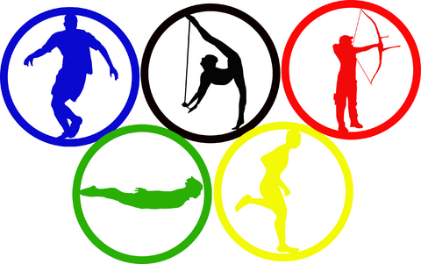

Olympic Dataset Analysis
Ali Riahi Samani
1

Slide 2
Olympics and Dataset
The first ancient Olympic Games can be traced back to 776 BC.
They were dedicated to the Olympian gods and were staged on the ancient plains of Olympia.
The dataset contains details of 120 years of modern Olympic Games from Athens 1896 to Rio 2016.
This dataset provides an opportunity to ask questions about how the Olympics have evolved over time, including questions about the participation and performance of women, different nations, and different sports and events.
Tools: Hadoop, Hive
2

Slide 3
Performed Analytics
Top 5 countries who have won the maximum number of medals over the years and the corresponding male versus female distribution of athletes (medal winners) for these countries?
For the USA, in the last 5 Olympics which sports have brought maximum gold, silver and bronze medals respectively?
What are the average age, height, and weight of a male or a female winning a gold, silver, and bronze respectively in badminton?
Top and Bottom 5 Olympics(years) in terms of the number of countries participated and the count of male and female athletes in those years?
Top 5 sports in terms of how many times they were part of an Olympics over the years, and which were the years they were NOT part of an Olympics?
Top 5 countries that had the biggest difference between their summer and winter gold medal counts?
Top 5 cities which have hosted most number of Olympics in summer and winter respectively?
3

Slide 4
Q1:Top 5 Countries Winning most Medals - Result
Top 5 countries who have won the maximum number of medals over the years and the corresponding male versus female distribution of athletes (medal winners) for these countries.
Columns used: id, sport, event, noc, region, medal, sex
4

Slide 5
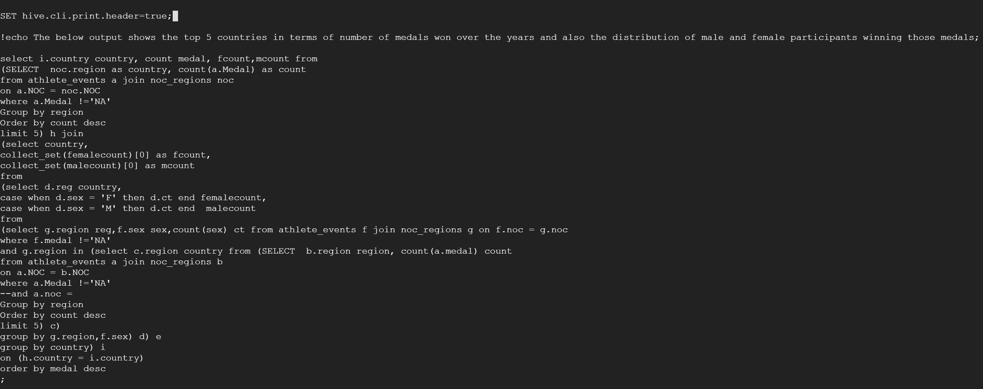
Q1:Top 5 Countries Winning most Medals- Query

Slide 6
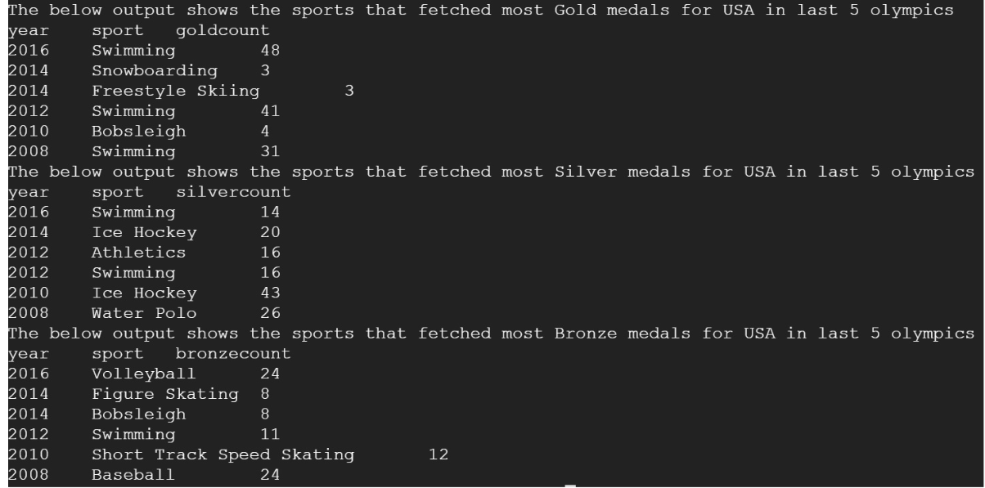
Q2:Winning Sports in USA in Last 5 Olympics -Result
For the USA, in the last 5 Olympics which sports have brought maximum gold, silver and bronze medals
Columns used: id, sport, event, year, medal, noc, region
6

Slide 7
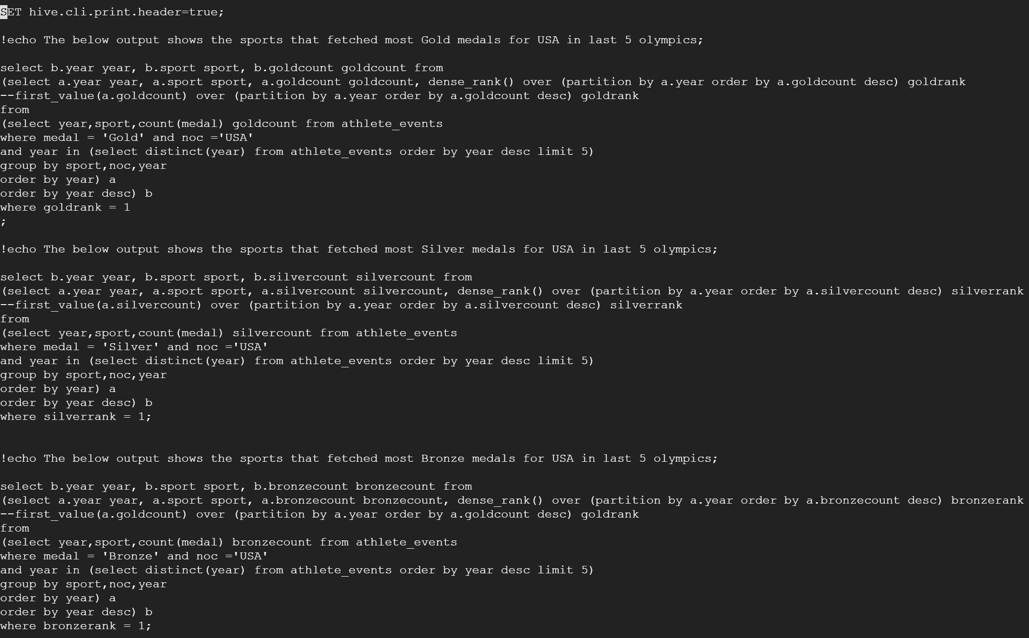
Q2:Winning Sports in USA in Last 5 Olympics -Query
7

Slide 8
Q3:Average Attributes for a Badminton Medal - Result
What are the average physical characteristics of a male or a female winning a gold, silver, and bronze respectively in badminton?
Columns Used: id, sport, event, medal, age, height, weight, sex
8

Slide 9
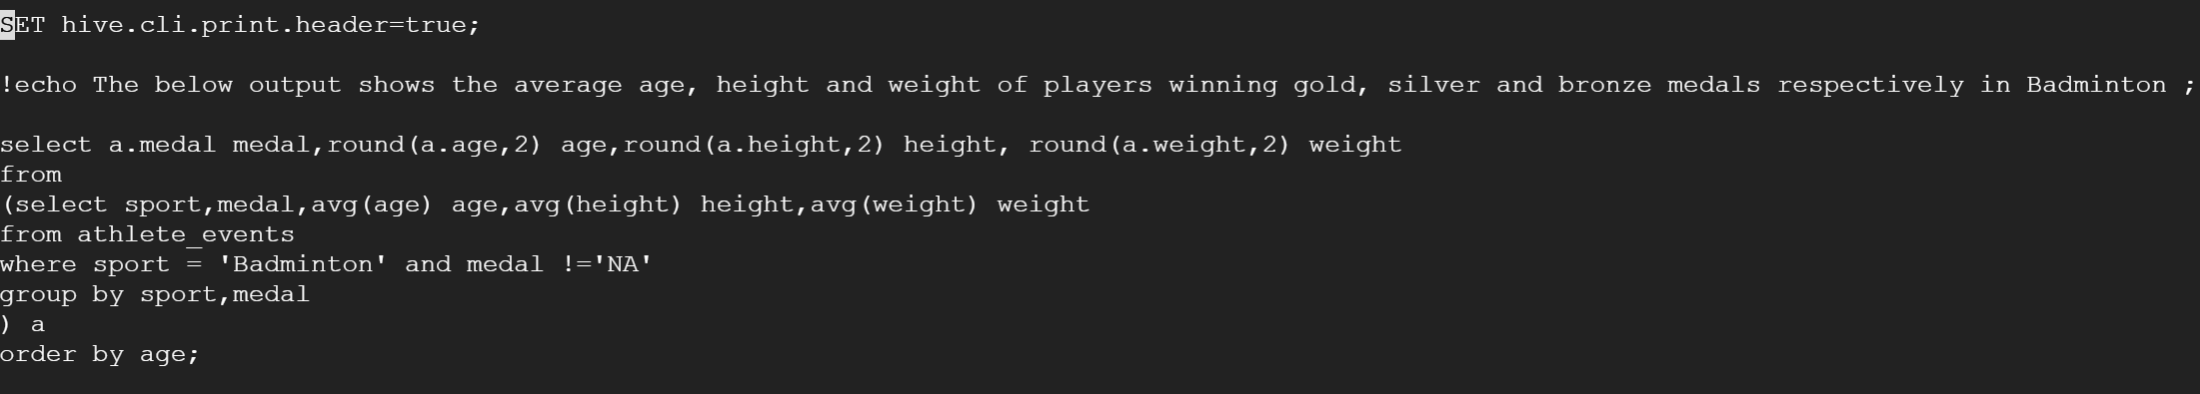
Q3:Average Attributes for a Badminton Medal - Query
9

Slide 10
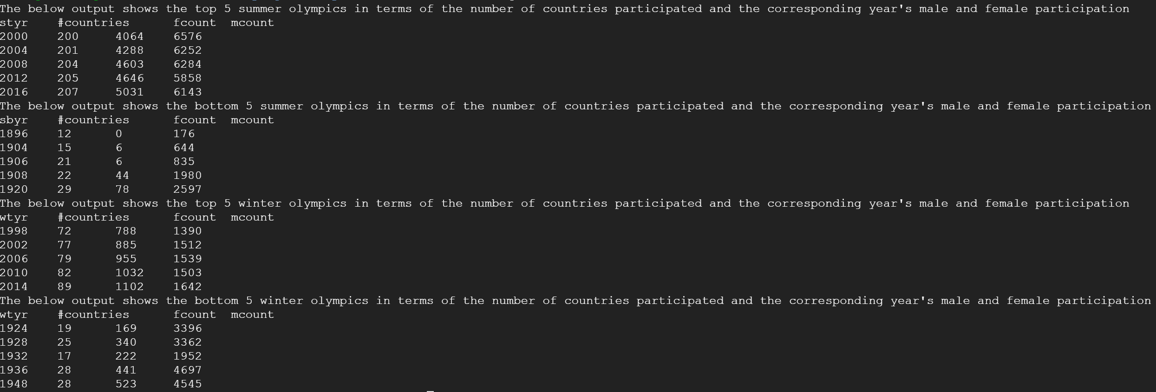
Q4:Highest and Lowest Participation Years -Query
Top and Bottom 5 Olympics(years) for both winter and summer Olympics in terms of the number of countries participated and the count of male and female athletes in those years
Columns used: id, sport, event, noc, region, year, sex
10

Slide 11
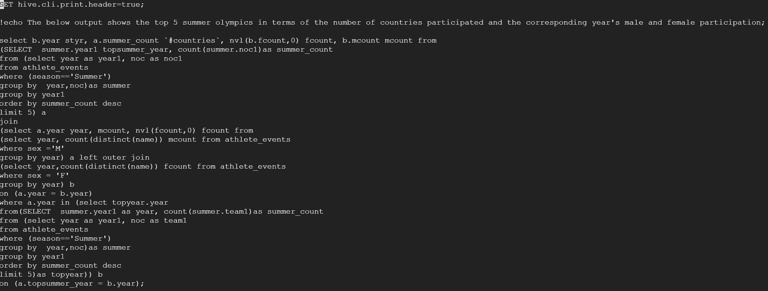
Q4:Highest and Lowest Participation Years - Query
11

Slide 12
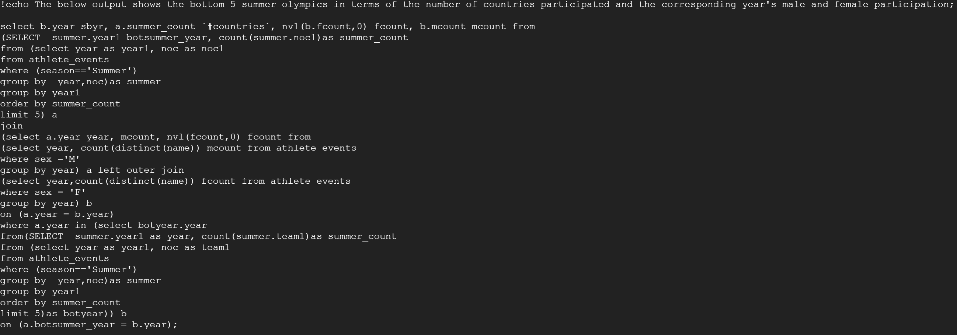
Q4:Highest and Lowest Participation Years – Query..
12

Slide 13
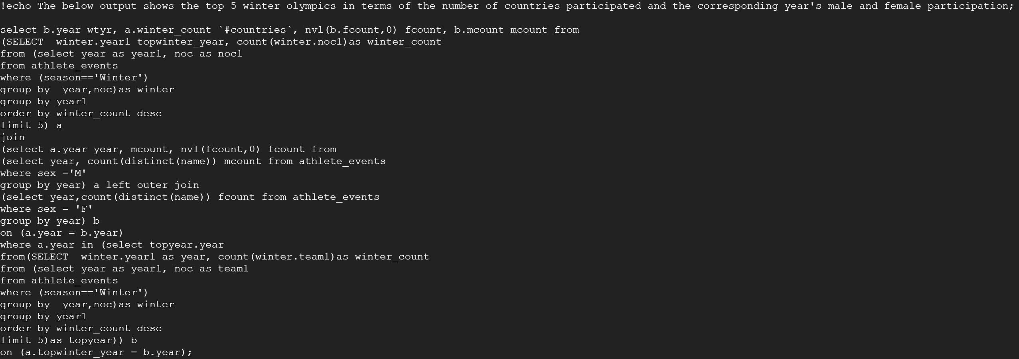
Q4:Highest and Lowest Participation Years – Query..
13

Slide 14
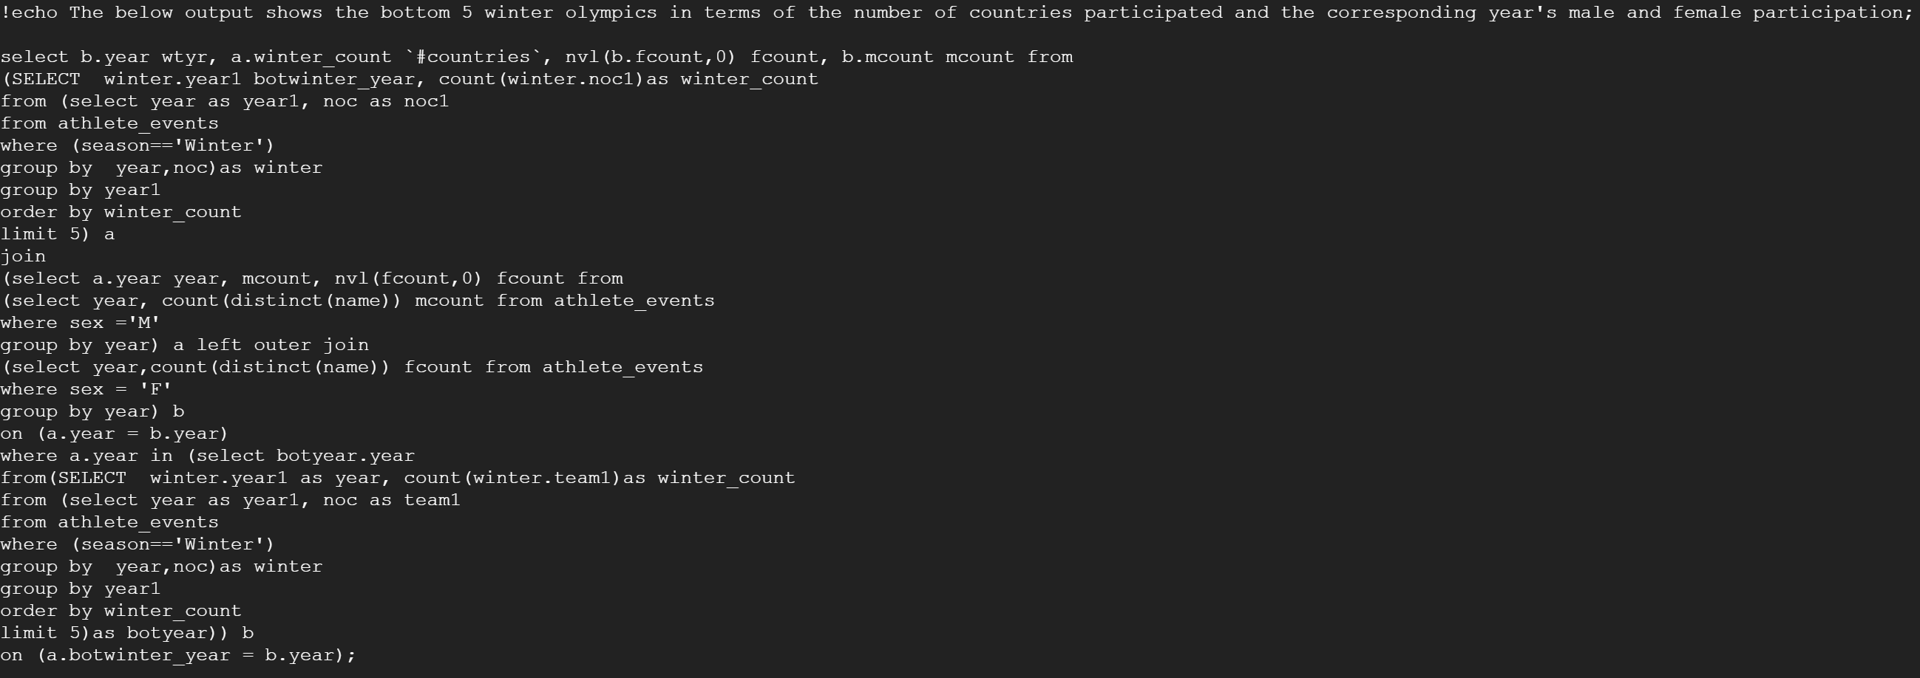
Q4:Highest and Lowest Participation Years – Query..
14

Slide 15
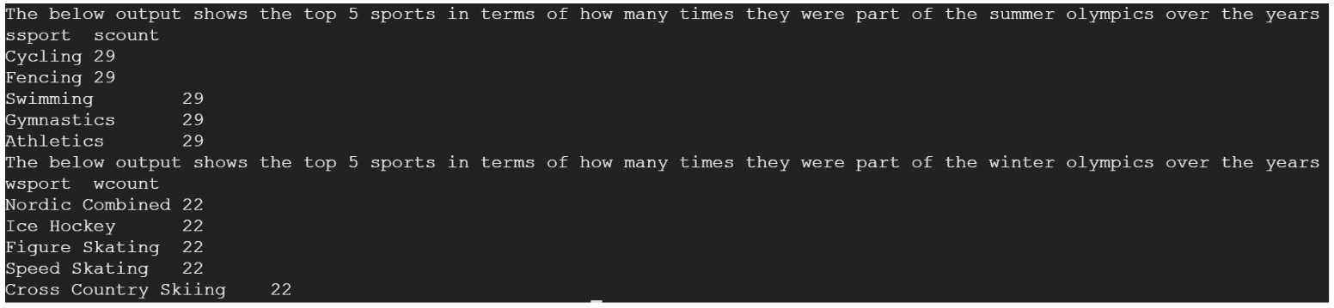
Q5:Top 5 Sports in Olympics - Result
Top 5 sports in terms of how many times they were part of an Olympics over the years, and which were the years they were NOT part of an Olympics
Columns used: id, sport, event, year
15

Slide 16
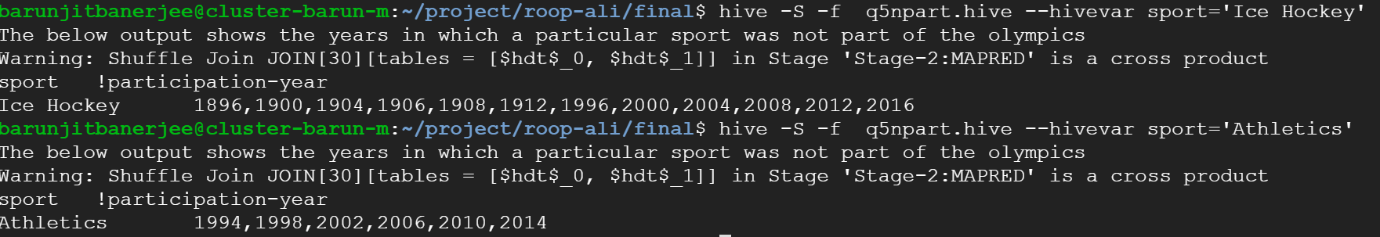
Q5:Top 5 Sports in Olympics – Result..
Top 5 sports in terms of how many times they were part of an Olympics over the years, and which were the years they were NOT part of an Olympics
Columns used: id, sport, event, year
16

Slide 17
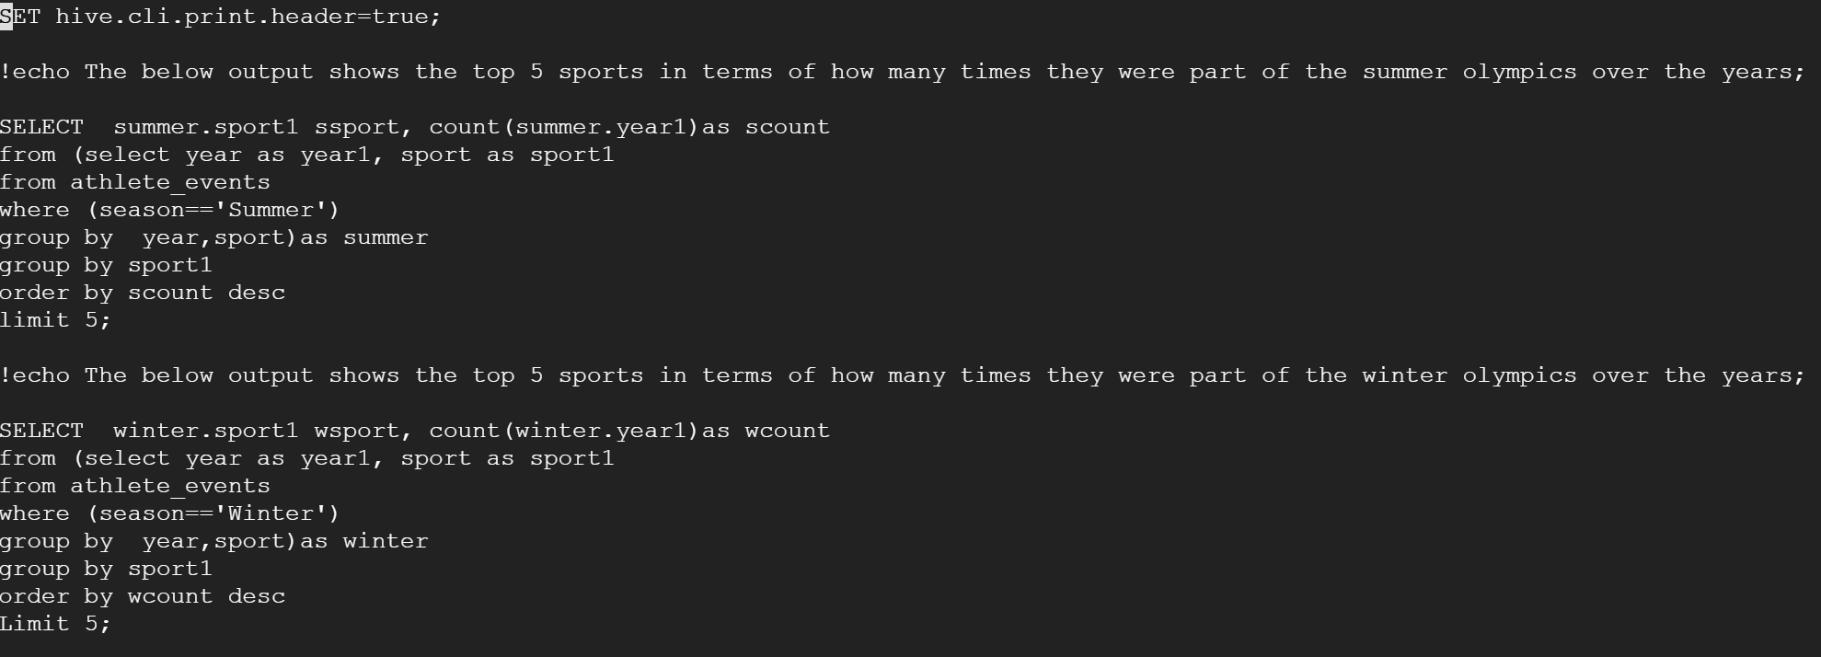
Q5:Top 5 Sports in Olympics - Query
17

Slide 18
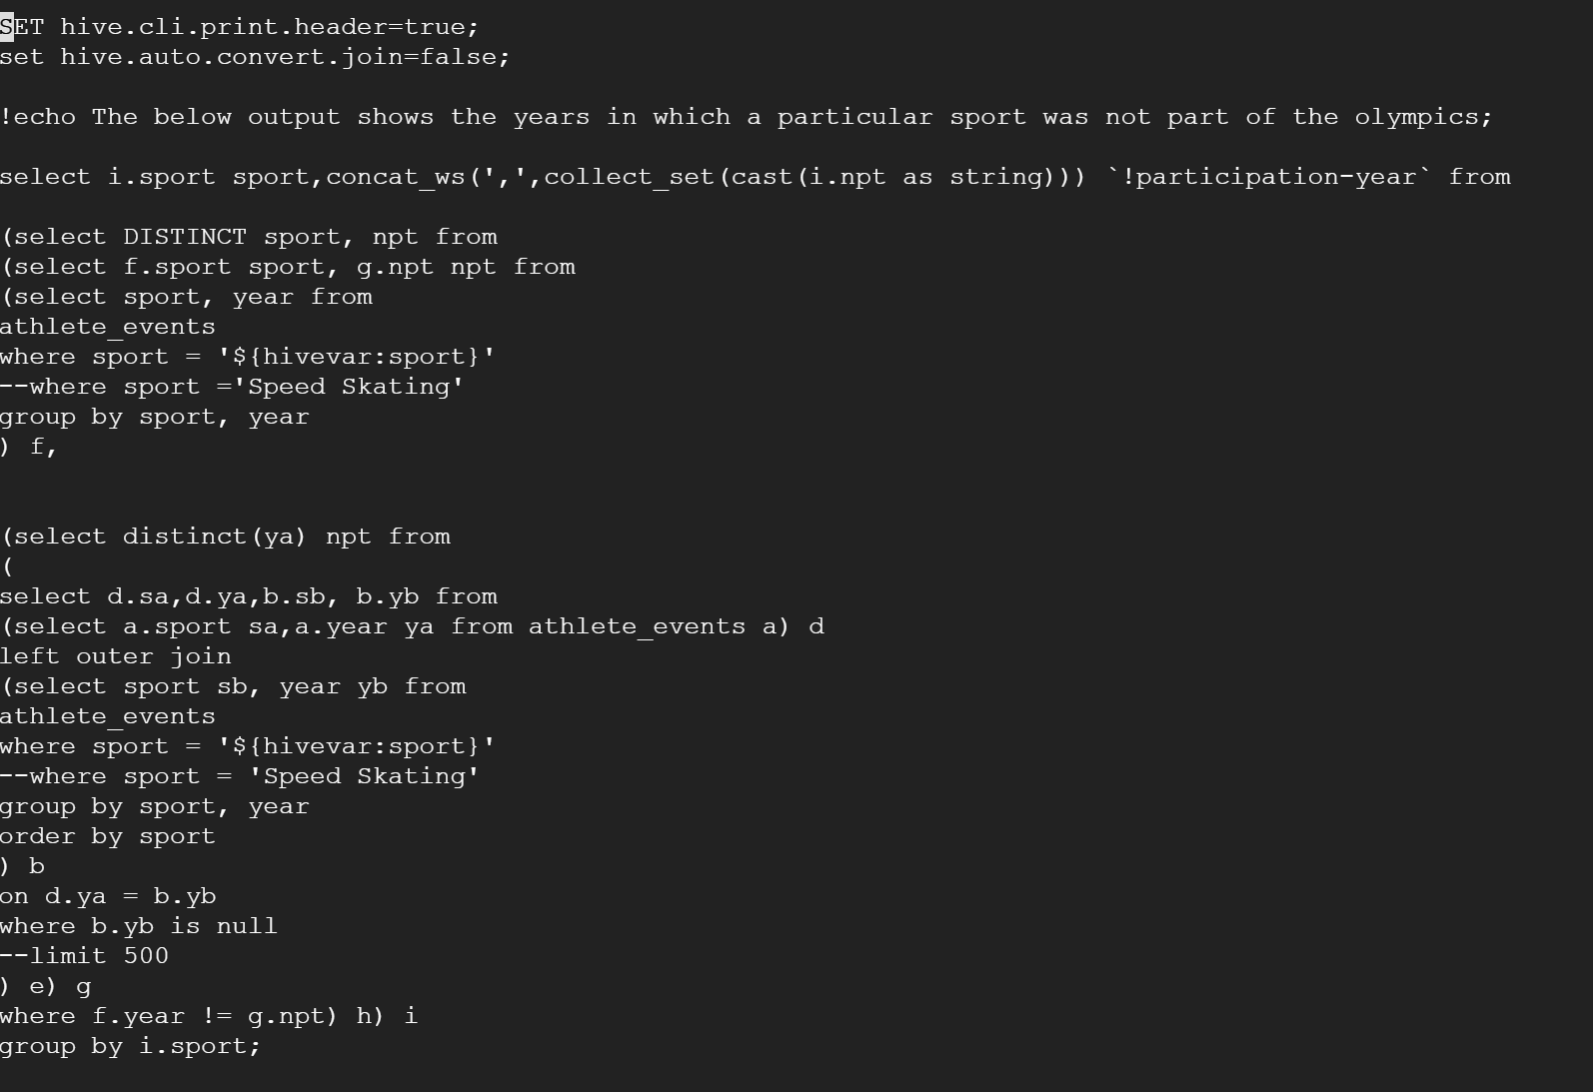
Q5:Top 5 Sports in Olympics – Query..
18

Slide 19
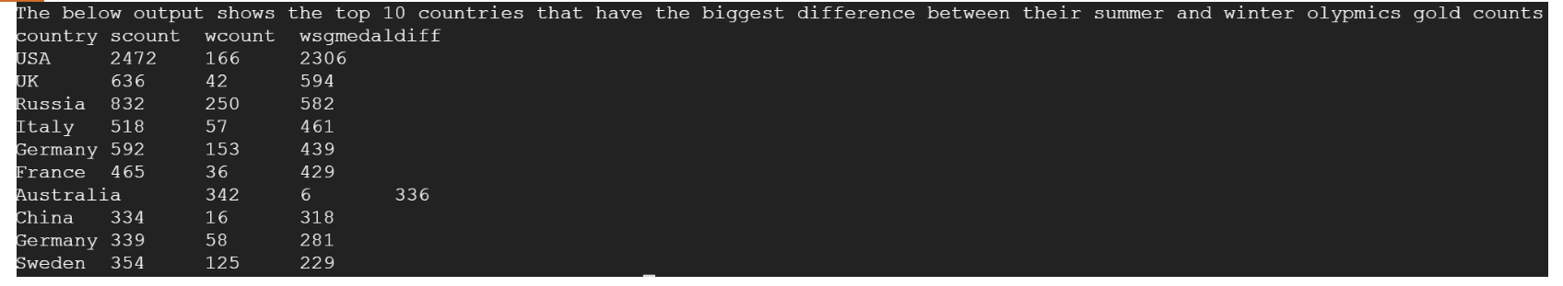
Q6:Top 10 Country with Max Summer - Winter Diff - Result
Top 10 countries that had the biggest difference between their summer and winter gold medal counts
Columns used: id, sport, event, noc, region, year, season, medal
19

Slide 20
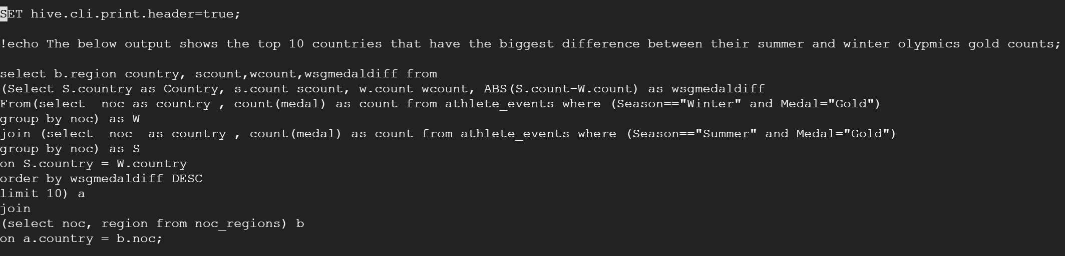
Q6:Top 10 Country with Max Summer - Winter Diff -Query
20

Slide 21
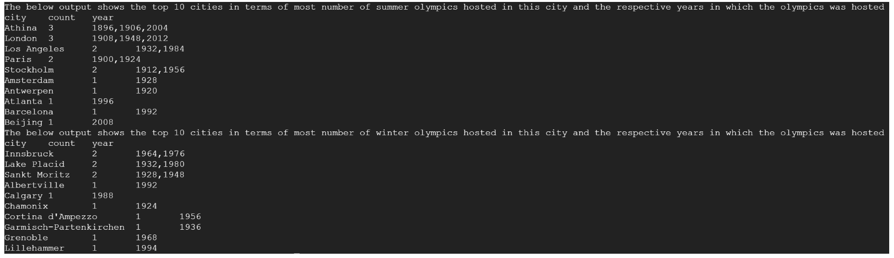
Q7:Top 5 Host Cities in Summer and Winter - Result
Top 5 cities which have hosted most number of Olympics in summer and winter respectively
Columns used: id, sport, event, city, season, year, noc, region
16

Slide 22
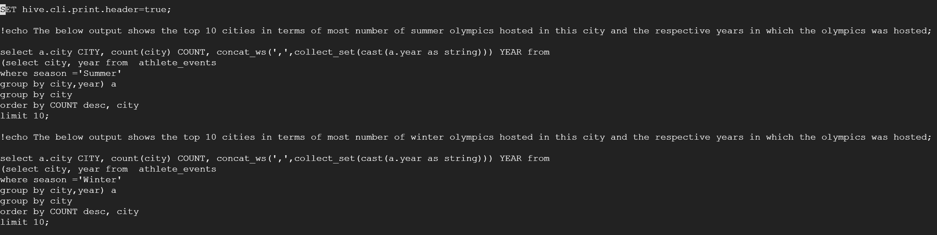
Q7:Top 5 Host Cities in Summer and Winter - Query
17

Slide 23
Data Source and References
https://www.kaggle.com/heesoo37/120-years-of-olympic-history-athletes-and-results
https://en.wikipedia.org/wiki/Olympic_Games
https://www.olympic.org/ancient-olympic-games/history-old

